Slide 1
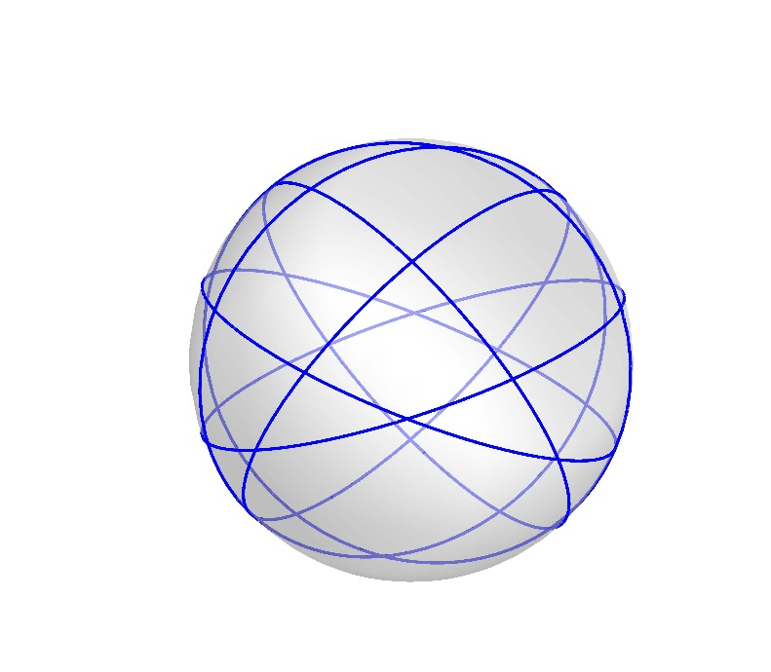
Great Circles Problem
Kha Man

Slide 2
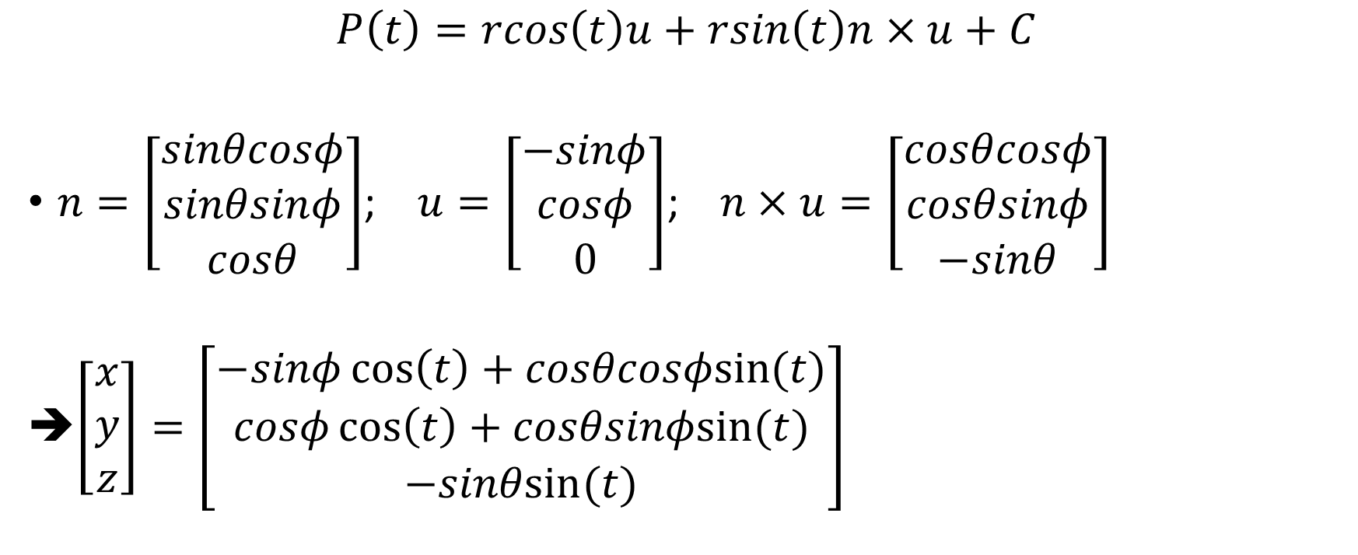
Creating great circles
$$P\left(t\right)=rcos\left(t\right)u+rsin\left(t\right)n×u+C$$
$n=\left[\begin{matrix}sinθcosφ \\ sinθsinφ \\ cosθ\end{matrix}\right]$; $u=\left[\begin{matrix}−sinφ \\ cosφ \\ 0\end{matrix}\right]$; $n×u=\left[\begin{matrix}cosθcosφ \\ cosθsinφ \\ −sinθ\end{matrix}\right]$
➔$\left[\begin{matrix}x \\ y \\ z\end{matrix}\right]=\left[\begin{matrix}−sinφ\cos\left(t\right)+cosθcosφsin⁡(t) \\ cosφ\cos\left(t\right)+cosθsinφsin⁡(t) \\ −sinθsin⁡(t)\end{matrix}\right]$

Slide 3




The middle line
Definition: The middle line is a 3D line created by 2 planes containing 2 great circles that have $α_{2}is closest to \frac{π}{2}$ where:
$α_{1}$ is the inclination angle when a line is projected to the plane Oxy
$α_{2}$ is the angle formed by the projected line of a 3D line to the plane Oxy and Ox
Oz
$$ℓ$$
Oy
$$α_{1}$$
$$α_{2}$$
O
Ox

Slide 4
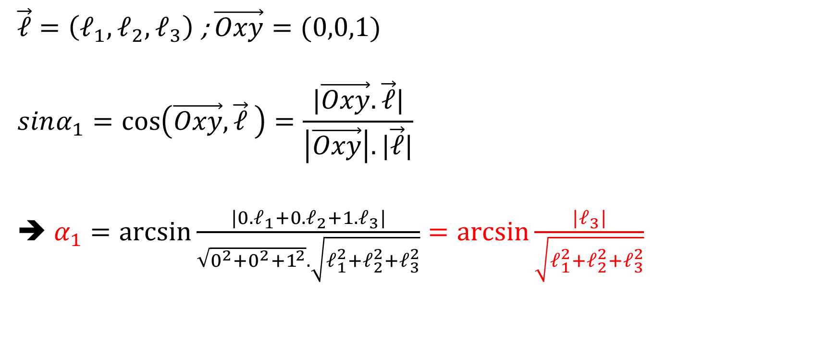
The middle line
$\vec{ℓ}=\left(ℓ_{1},ℓ_{2},ℓ_{3}\right)$ ; $\vec{Oxy}=(0,0,1)$
$$sinα_{1}=\cos\left(\vec{Oxy}, \vec{ℓ} \right)=\frac{|\vec{Oxy}.\vec{ℓ}|}{\left|\vec{Oxy}\right|.|\vec{ℓ}|}$$
➔ $α_{1}=\arcsin{\frac{|0.ℓ_{1}+0.ℓ_{2}+1.ℓ_{3}|}{\sqrt{0^{2}+0^{2}+1^{2}}.\sqrt{ℓ_{1}^{2}+ℓ_{2}^{2}+ℓ_{3}^{2}}}=\arcsin{\frac{|ℓ_{3}|}{\sqrt{ℓ_{1}^{2}+ℓ_{2}^{2}+ℓ_{3}^{2}}}}}$
Notes:
http://www.vitutor.com/geometry/distance/line_plane.html

Slide 5
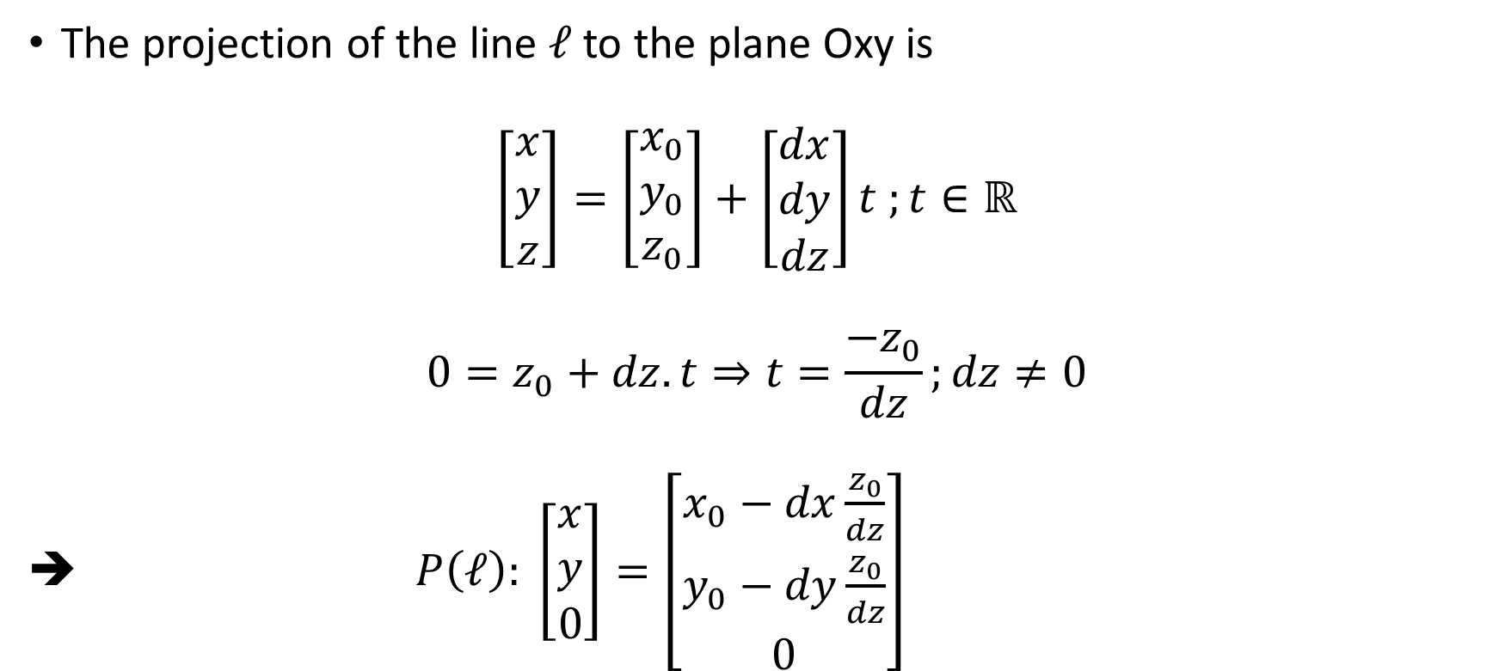
The projection of the line $ℓ$ to the plane Oxy is
$$\left[\begin{matrix}x \\ y \\ z\end{matrix}\right]=\left[\begin{matrix}x_{0} \\ y_{0} \\ z_{0}\end{matrix}\right]+\left[\begin{matrix}dx \\ dy \\ dz\end{matrix}\right]t ;t∈ℝ$$
$${0=z}_{0}+dz.t⇒t=\frac{−z_{0}}{dz};dz≠0$$
➔ $P\left(ℓ\right): \left[\begin{matrix}x \\ y \\ 0\end{matrix}\right]=\left[\begin{matrix}x_{0}−dx\frac{z_{0}}{dz} \\ y_{0}−dy\frac{z_{0}}{dz} \\ 0\end{matrix}\right]$

Slide 6
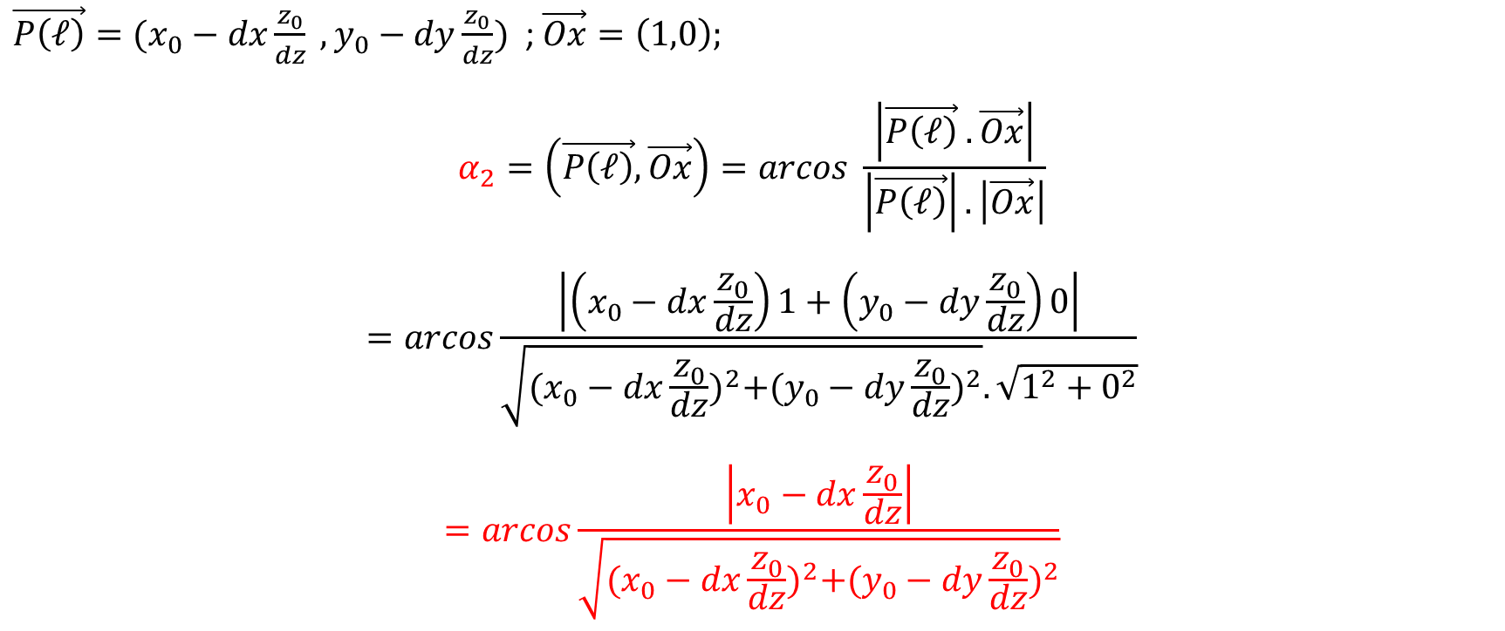
$\vec{P\left(ℓ\right)}=(x_{0}−dx\frac{z_{0}}{dz} ,y_{0}−dy\frac{z_{0}}{dz})$ ; $\vec{Ox}=\left(1,0\right);$
$$α_{2}=\left(\vec{P\left(ℓ\right)}, \vec{Ox}\right)=arcos \frac{\left|\vec{P\left(ℓ\right)} .\vec{Ox}\right|}{\left|\vec{P\left(ℓ\right)}\right|.\left|\vec{Ox}\right|}$$
$$=arcos\frac{\left|\left(x_{0}−dx\frac{z_{0}}{dz}\right)1+\left(y_{0}−dy\frac{z_{0}}{dz}\right)0\right|}{\sqrt{{(x_{0}−dx\frac{z_{0}}{dz})}^{2}+{(y_{0}−dy\frac{z_{0}}{dz})}^{2}}.\sqrt{1^{2}+0^{2}}}$$
$$=arcos\frac{\left|x_{0}−dx\frac{z_{0}}{dz}\right|}{\sqrt{{(x_{0}−dx\frac{z_{0}}{dz})}^{2}+{(y_{0}−dy\frac{z_{0}}{dz})}^{2}}}$$

Slide 7

The middle line
Therefore, the middle line is the line that has
$α_{2}=max\left(α_{2i}\right)=max⁡{(acos\frac{\left|x_{0}−dx\frac{z_{0}}{dz}\right|}{\sqrt{{(x_{0}−dx\frac{z_{0}}{dz})}^{2}+{(y_{0}−dy\frac{z_{0}}{dz})}^{2}}})}_{i}$

Slide 8
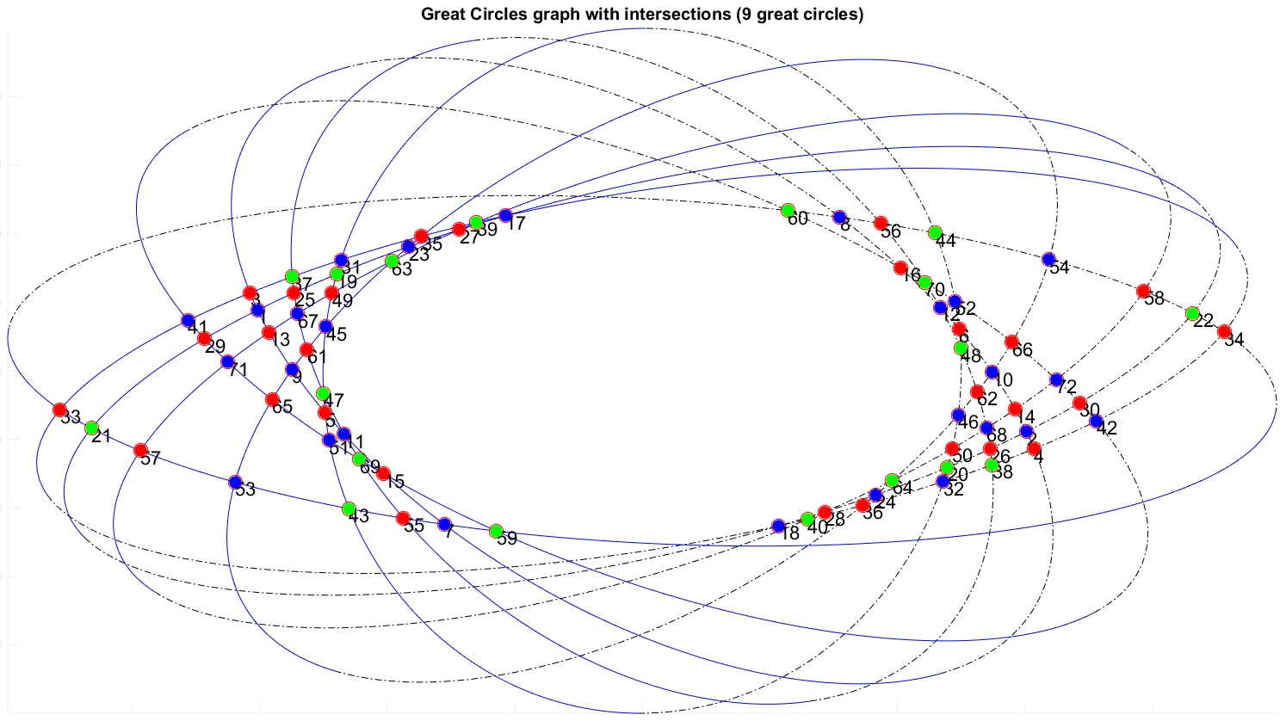
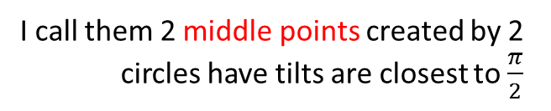
An example case (9 great circles)
I call them 2 middle points created by 2 circles have tilts are closest to $\frac{π}{2}$
. O
The middle line
: Top
----------- : Bot

Slide 11
The middle line

